Slide 1

Punctuality Alarm
An Open Source Software Development Project By
Varsha Radhakrishnan

Slide 2
Who needs this?
Anyone who finds it hard to be punctual for his/her appointments, particularly due to traffic congestion!!
It is for people who need the remainder “YES, its time to start your journey, or you will end up late for your appointment”

Slide 3
Features
An app that periodically monitors the traffic and tells us the right time to start from home to reach the destination on time.
Mostly, we can solve only issues arising out of bad planning or traffic conditions changing unexpectedly.

Slide 4
Features..
Works just like an alarm clock.
Give the app inputs like source, destination,time. It gives your an alarm 15 minutes prior to actual start time.

Slide 5
Motivation
The point is, I need not go online and check every time if the traffic conditions have changed.
If the roads are blocked due to some unexpected traffic event (accidents, closures etc), the user is alerted well in advance.

Slide 6
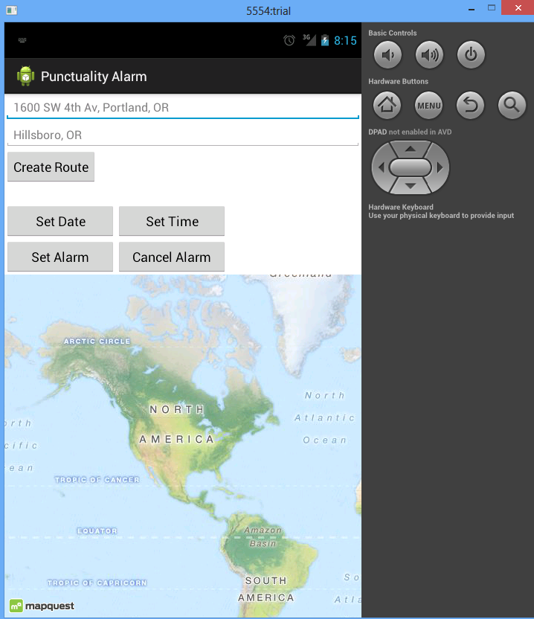

Slide 7
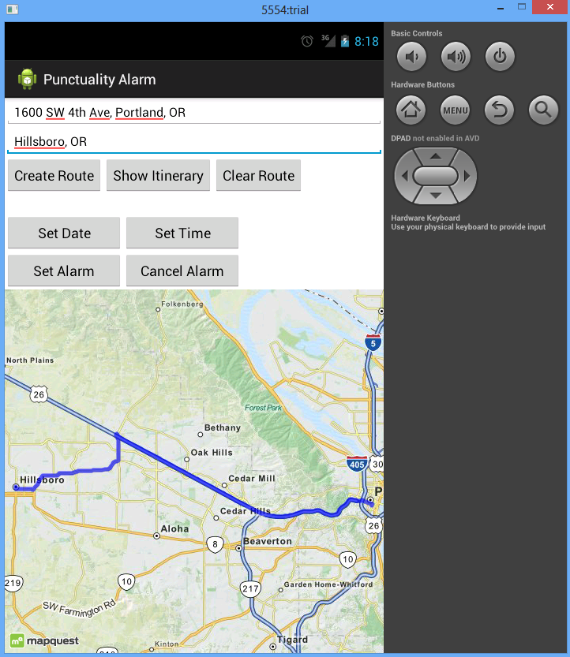

Slide 8
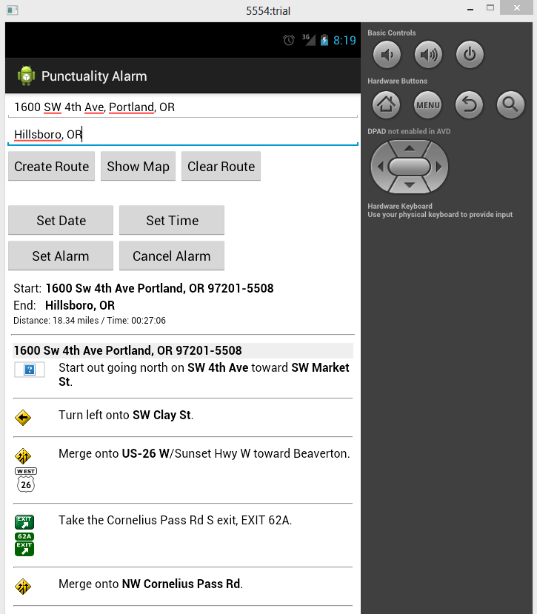

Slide 9
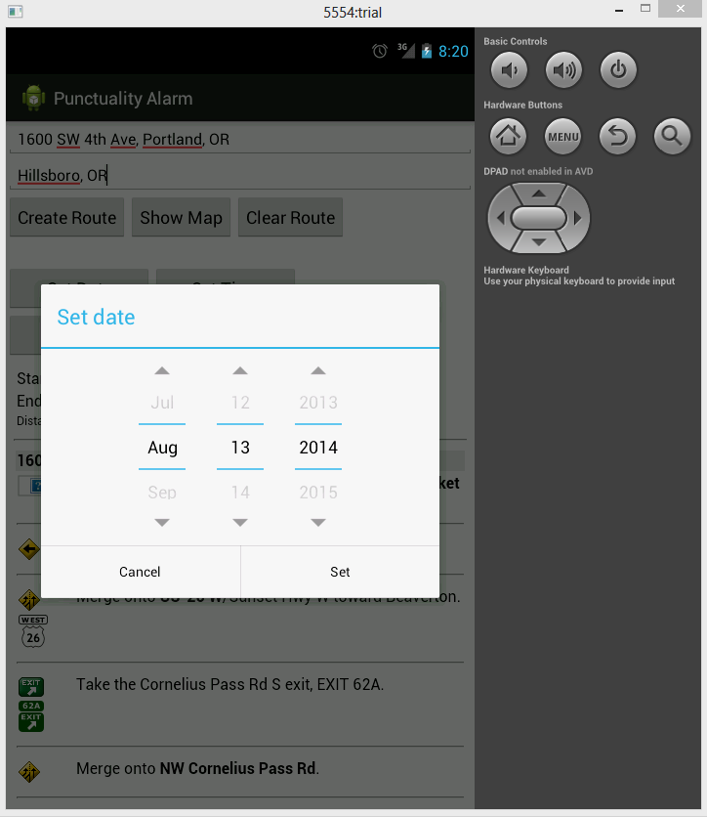

Slide 10
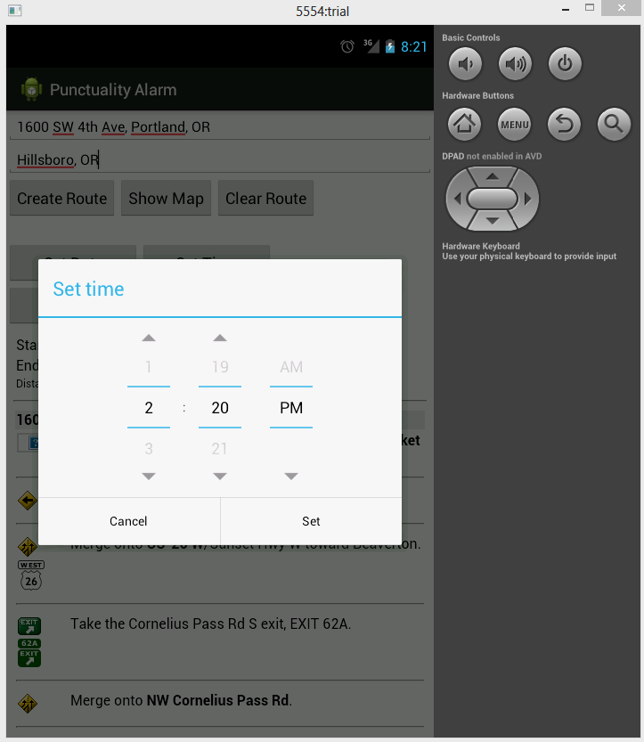

Slide 11
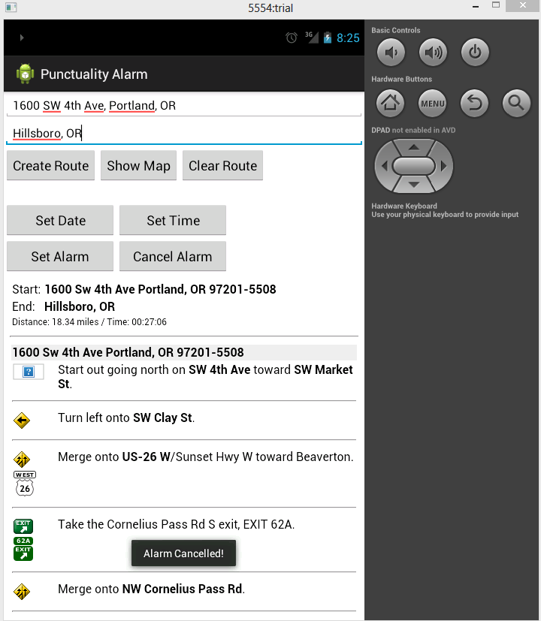

Slide 12
Various decisions and challenges
Real time traffic data
API - Google Vs MapQuest
MapQuest documentation
Integrating web services into an android app : In Mapquest, ‘realTime’ travel time is present for its Directions api web service and not for its android api.

Slide 13
Various decisions and challenges
AlarmManager implementation to wake up a service periodically- Getting the service to work correctly
Several recommendations found online had outdated ideas/code which Android discourages

Slide 14
What didn’t work
Initial choice of APIs
Bad programming choice about updating UI periodically using a service.

Slide 15
Improvements
Provision for setting many alarms
Improve the User Interface
Option for choosing the travel path
Can include the Trimet travel time in the future.

Slide 16
Details
Source code:
https://github.com/rvarsha/Punctuality-alarm
License : GNU GENERAL PUBLIC LICENSE v2
Contact Details:
varsha@pdx.edu

Slide 17
Thank you..

